Slide 1
Syntax Analysis Or Parsing
Lecture 08

Slide 2
Bottom-Up Parsing
A bottom-up parser creates the parse tree of the given input starting from leaves towards the root
A bottom-up parser tries to find the right-most derivation of the given input in the reverse order.
S ⇒ ... ⇒ ω (the right-most derivation of ω)
← (the bottom-up parser finds the right-most derivation in the reverse order)

Slide 3
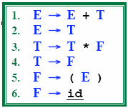
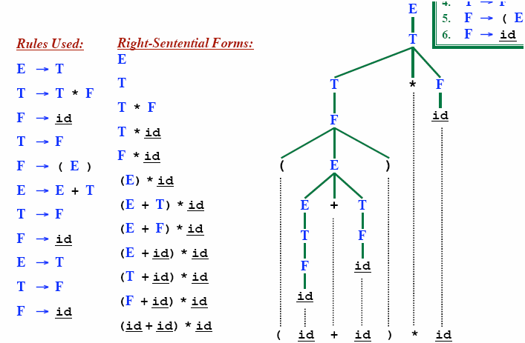
Rightmost Derivation

Slide 4
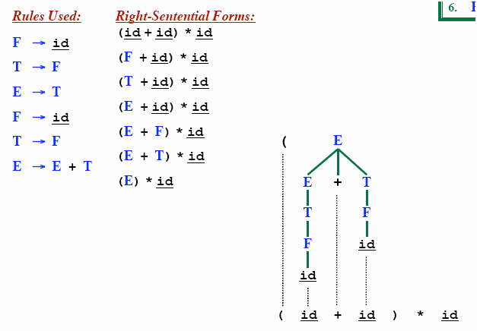
Rightmost Derivation In Reverse

Slide 5
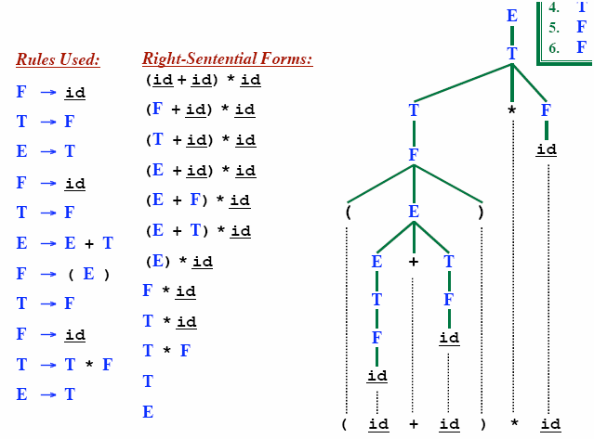
Rightmost Derivation In reverse
LR parsing corresponds to rightmost derivation in reverse

Slide 6
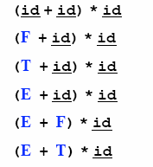
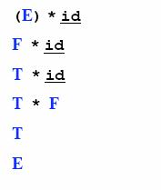
Reduction
A reduction step replaces a specific substring (matching the body of a production)
Reduction is the opposite of derivation
Bottom up parsing is a process of reducing a string ω
to the start symbol S of the grammar

Slide 7
Handle
Informally, a handle is a substring (in the parsing string) that matches the right side of a production rule.
– But not every substring matches the right side of a production rule is handle
A handle of a right sentential form γ (≡ αβω) is a production rule A → β and a position of γ
where the string β may be found and replaced by A to produce the previous right-sentential form in a rightmost derivation γ .
S ⇒ αAω ⇒ αβω

Slide 8
Handle Pruning
A right-most derivation in reverse can be obtained by
handle-pruning.
n-th right-sentential form
rm rm rm rm rm
S=γ₀ ⇒ γ₁ ⇒ γ₂ ⇒ ... ⇒ γ_{n-1} ⇒ γ_{n}= ω
input string
Start from γ_{n}, find a handle A_{n}→β_{n} in γ_{n}, and replace β_{n} in by A_{n} to get γ_{n-1}.
Then find a handle A_{n-1}→β_{n-1} in γ_{n-1}, and replace β_{n-1} in by A_{n-1} to get γ_{n-2}.
Repeat this, until we reach S.

Slide 9
Shift-Reduce Parsing
Bottom-up parsing is also known as shift-reduce parsing because its two main actions are shift and reduce.
data structures: input-string and stack
Operations
At each shift action, the current symbol in the input string is pushed to a stack.
At each reduction step, the symbols at the top of the stack (this symbol sequence is the right side of a production) will replaced by the non-terminal at the left side of that production.
Accept: Announce successful completion of parsing
Error: Discover a syntax error and call error recovery

Slide 10
Shift Reduce Parsing
_{Remaining input: abbcde}
S 🡪 a T R e
T 🡪 T b c | b
R 🡪 d
Rightmost derivation:
S 🡺 a T R e
🡺 a T d e
🡺 a T b c d e
🡺 a b b c d e

Slide 11
Shift Reduce Parsing
_{Remaining input: bcde}
S 🡪 a T R e
T 🡪 T b c | b
R 🡪 d
🡺
_{Shift a, Shift b}
_{a b}
Rightmost derivation:
S 🡺 a T R e
🡺 a T d e
🡺 a T b c d e
🡺 a b b c d e

Slide 12
Shift Reduce Parsing
_{Remaining input: bcde}
S 🡪 a T R e
T 🡪 T b c | b
R 🡪 d
🡺
_{Shift a, Shift b}
_{Reduce T 🡪 b}
🡺
_{T}
_{a b}
Rightmost derivation:
S 🡺 a T R e
🡺 a T d e
🡺 a T b c d e
🡺 a b b c d e

Slide 13
Shift Reduce Parsing
_{Remaining input: de}
S 🡪 a T R e
T 🡪 T b c | b
R 🡪 d
🡺
_{Shift a, Shift b}
_{Reduce T 🡪 b}
_{Shift b, Shift c}
🡺
_{T}
🡺
_{a b}
_{b c}
Rightmost derivation:
S 🡺 a T R e
🡺 a T d e
🡺 a T b c d e
🡺 a b b c d e

Slide 14
Shift Reduce Parsing
_{Remaining input: de}
S 🡪 a T R e
T 🡪 T b c | b
R 🡪 d
_{T}
🡺
_{Shift a, Shift b}
_{Reduce T 🡪 b}
_{Shift b, Shift c}
_{Reduce T 🡪 T b c}
🡺
_{T}
🡺
🡺
_{a b}
_{b c}
Rightmost derivation:
S 🡺 a T R e
🡺 a T d e
🡺 a T b c d e
🡺 a b b c d e

Slide 15
Shift Reduce Parsing
_{Remaining input: e}
S 🡪 a T R e
T 🡪 T b c | b
R 🡪 d
_{T}
🡺
_{Shift a, Shift b}
_{Reduce T 🡪 b}
_{Shift b, Shift c}
_{Reduce T 🡪 T b c}
_{Shift d}
🡺
_{T}
🡺
🡺
🡺
_{a b}
_{b c}
_{d}
Rightmost derivation:
S 🡺 a T R e
🡺 a T d e
🡺 a T b c d e
🡺 a b b c d e

Slide 16
Shift Reduce Parsing
_{Remaining input: e}
S 🡪 a T R e
T 🡪 T b c | b
R 🡪 d
_{T}
🡺
_{Shift a, Shift b}
_{Reduce T 🡪 b}
_{Shift b, Shift c}
_{Reduce T 🡪 T b c}
_{Shift d}
_{Reduce R 🡪 d}
🡺
_{T}
_{R}
🡺
🡺
🡺
_{a b}
_{b c}
_{d}
🡺
Rightmost derivation:
S 🡺 a T R e
🡺 a T d e
🡺 a T b c d e
🡺 a b b c d e

Slide 17
Shift Reduce Parsing
_{Remaining input:}
S 🡪 a T R e
T 🡪 T b c | b
R 🡪 d
_{T}
🡺
_{Shift a, Shift b}
_{Reduce T 🡪 b}
_{Shift b, Shift c}
_{Reduce T 🡪 T b c}
_{Shift d}
_{Reduce R 🡪 d}
_{Shift e}
🡺
_{T}
_{R}
🡺
🡺
🡺
_{a b}
_{b c}
_{d}
_{e}
🡺
Rightmost derivation:
S 🡺 a T R e
🡺 a T d e
🡺 a T b c d e
🡺 a b b c d e
🡺

Slide 18
Shift Reduce Parsing
_{Remaining input:}
S 🡪 a T R e
T 🡪 T b c | b
R 🡪 d
_{S}
_{T}
🡺
_{Shift a, Shift b}
_{Reduce T 🡪 b}
_{Shift b, Shift c}
_{Reduce T 🡪 T b c}
_{Shift d}
_{Reduce R 🡪 d}
_{Shift e}
_{Reduce S 🡪 a T R e}
🡺
_{T}
_{R}
🡺
🡺
🡺
_{a b}
_{b c}
_{d}
_{e}
🡺
Rightmost derivation:
S 🡺 a T R e
🡺 a T d e
🡺 a T b c d e
🡺 a b b c d e
🡺
🡺

Slide 19
Example Shift-Reduce Parsing
Consider the grammar:
Stack
Input
Action
$ | id₁ + id₂$ | shift
$id₁ | + id₂$ | reduce 6
$F | + id₂$ | reduce 4
$T | + id₂$ | reduce 2
$E | + id₂$ | shift
$E + | id₂$ | shift
$E + id₂ |  | reduce 6
$E + F |  | reduce 4
$E + T |  | reduce 1
$E |  | accept

Slide 20
Shift-Reduce Parsing
Handle will always appear on Top of stack, never inside
Possible forms of two successive steps in any rightmost derivation
CASE 1:
STACK
$αβγ
INPUT
yz$
S
After Reducing the handle
A
$αβB
yz$
B
Shifting from Input
α
β
γ
y z
$αβBy
z$
S ⇒* αAz ⇒ αβByz ⇒ αβγyz
rm rm rm
Reduce the handle
$αA
z$

Slide 21
Shift-Reduce Parsing
Case 2:
STACK
$αγ
INPUT
xyz$
After Reducing the handle
xyz$
Shifting from Input
z$
Reducing the handle
z$
S
B
^{α} γ ^{x}
S ⇒* αBxAz ⇒ αBxyz ⇒ αγxyz
rm rm rm
$αB
A
y z
$αBxy
$αBxA

Slide 22
Conflicts During Shift-Reduce Parsing
There are context-free grammars for which shift-reduce parsers cannot be used.
Stack contents and the next input symbol may not decide action:
shift/reduce conflict: Whether make a shift operation or a reduction.
reduce/reduce conflict: The parser cannot decide which of several reductions to make.
If a shift-reduce parser cannot be used for a grammar, that grammar is called as non-LR(k) grammar.
left to right scanning
right-most derivation
k lookhead
An ambiguous grammar can never be a LR grammar.

Slide 23
Shift-Reduce Conflict in Ambiguous Grammar
stmt → if expr then stmt
| if expr then stmt else stmt
| other
STACK INPUT
….if expr then stmt else….$
We can’t decide whether to shift or reduce?

Slide 24
Reduce-Reduce Conflict in Ambiguous Grammar
stmt → id(parameter_list)
stmt → expr:=expr
parameter_list → parameter_list, parameter
parameter_list → parameter
parameter_list → id
expr → id(expr_list)
expr → id
expr_list → expr_list, expr
expr_list → expr
STACK INPUT
….id ( id , id ) …$
We can’t decide which production will be used to reduce id?

Slide 25

Shift-Reduce Parsers
There are two main categories of shift-reduce parsers
1. Operator-Precedence Parser
– simple, but only a small class of grammars.
CFG LR LALR
SLR
LR-Parsers
covers wide range of grammars.
SLR – simple LR parser
LR – most general LR parser
LALR – intermediate LR parser (lookhead LR parser)
SLR, LR and LALR work same, only their parsing tables are different.

Slide 26
LR Parsers
LR parsing is attractive because:
LR parsing is most general non-backtracking shift-reduce parsing,
yet it is still efficient.
The class of grammars that can be parsed using LR methods is a proper superset of the class of grammars that can be parsed with predictive parsers.
LL(1)-Grammars ⊂ LR(1)-Grammars
An LR-parser can detect a syntactic error as soon as it is possible to do so a left-to-right scan of the input.
LR parsers can be constructed to recognize virtually all programming language constructs for which CFG grammars canbe written
Drawback of LR method:
Too much work to construct LR parser by hand
Fortunately tools (LR parsers generators) are available

Slide 27
LL vs. LR
LR (shift reduce) is more powerful than LL (predictive parsing)
Can detect a syntactic error as soon as possible.
LR is difficult to do by hand (unlike LL)

Slide 28
LR Parsing Algorithm
input
stack
a₁ | ... | a_{i} | ... | a_{n} | $
S_{m}
X_{m}
^{S}m-1
^{X}m-1
.
.
S₁
X₁
S₀
LR Parsing Algorithm
output
Action Table terminals and $ |  | Goto Table non-terminal
s t a t e s | four different actions | s t each item is a a state number t e s

Slide 29
A Configuration of LR Parsing Algorithm
A configuration of a LR parsing is:
( S_{o} X₁ S₁ ... X_{m} S_{m}, a_{i} a_{i+1} ... a_{n} $ )
Stack Rest of Input
S_{m} and a_{i} decides the parser action by consulting the parsing action table. (Initial Stack contains just S_{o} )
A configuration of a LR parsing represents the right sentential form:
X₁ ... X_{m} a_{i} a_{i+1} ... a_{n} $

Slide 30
Actions of A LR-Parser
shift s -- shifts the next input symbol and the state s onto the stack
( S_{o} X₁ S₁ ... X_{m} S_{m}, a_{i} a_{i+1} ... a_{n} $ ) € ( S_{o} X₁ S₁ ... X_{m} S_{m} a_{i} s, a_{i+1} ... a_{n} $ )
reduce A→β (or rN where N is a production number)
pop 2|β| (=r) items from the stack;
then push A and s where s=goto[s_{m-r},A]
( S_{o} X₁ S₁ ... X_{m} S_{m}, a_{i} a_{i+1} ... a_{n} $ ) € ( S_{o} X₁ S₁ ... X_{m-r} S_{m-r} A s, a_{i} ... a_{n} $ )
Output is the reducing production reduce A→β
Accept – Parsing successfully completed
Error -- Parser detected an error (an empty entry in the action table)

Slide 31
Reduce Action
pop 2|β| (=r) items from the stack; let us assume that
β = Y₁Y₂...Y_{r}
then push A and s where s=goto[s_{m-r},A]
( S_{o} X₁ S₁ ... X_{m-r} S_{m-r} Y₁ S_{m-r} ...Y_{r} S_{m}, a_{i} a_{i+1} ... a_{n} $ )
€ ( S_{o} X₁ S₁ ... X_{m-r} S_{m-r} A s, a_{i} ... a_{n} $ )
In fact, Y₁Y₂...Y_{r} is a handle.
X₁ ... X_{m-r} A a_{i} ... a_{n} $ c X₁ ... X_{m} Y₁...Y_{r} a_{i} a_{i+1} ... a_{n} $

Slide 32
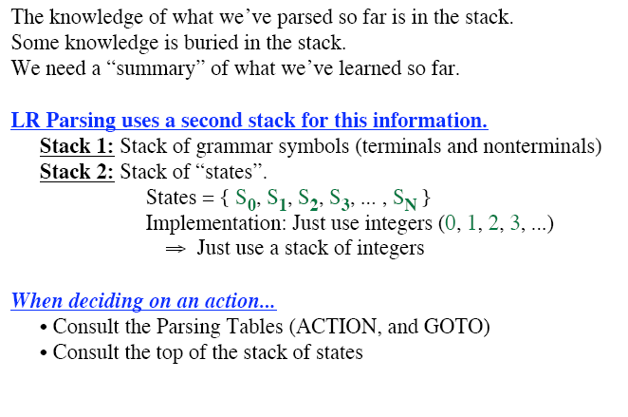
LR Parser Stack(s)

Slide 33
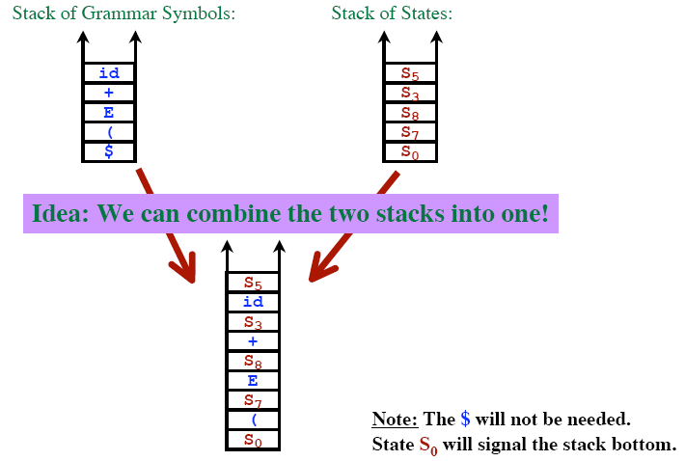
LR Parser Stack(s)

Slide 34
Constructing SLR Parsing Tables – LR(0) Item
An item indicates how much of a production we have seen at a given point in the parsing process
For Example the item A → X ∙ YZ
We have already seen on the input a string derivable from X
We hope to see a string derivable from YZ
For Example the item A → ∙ XYZ
We hope to see a string derivable from XYZ
For Example the item A → XYZ ∙
We have already seen on the input a string derivable from XYZ
It is possibly time to reduce XYZ to A
Special Case:
Rule: A → ε yields only one item A → ∙

Slide 35
Constructing SLR Parsing Tables
A collection of sets of LR(0) items (the canonical LR(0) collection) is the basis for constructing SLR parsers.
Canonical LR(0) collection provides the basis of constructing a DFA called LR(0) automaton
This DFA is used to make parsing decisions
Each state of LR(0) automaton represents a set of items in the canonical LR(0) collection
To construct the canonical LR(0) collection for a grammar
Augmented Grammar
CLOSURE function
GOTO function

Slide 36
Constructing SLR Parsing Tables – LR(0) Item
An LR(0) item of a grammar G is a production of G a dot at the some position of the right side.
Ex: | A → aBb | Possible LR(0) Items: | A → ∙ aBb
 |  | (four different possibility) | A → a ∙ Bb
 |  |  | A → aB ∙ b
 |  |  | A → aBb ∙
Sets of LR(0) items will be the states of action and goto table of the SLR parser.
– States represent sets of “items”
LR parser makes shift-reduce decision by maintaining states to keep track of where we are in a parsing process

Slide 37
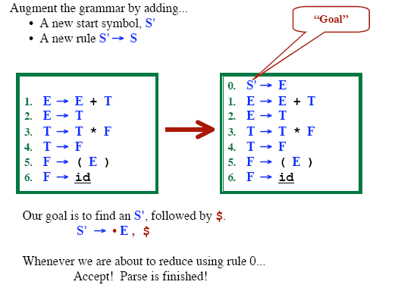
Grammar Augmentation

Slide 38
The Closure Operation
If I is a set of LR(0) items for a grammar G, then closure(I) is the set of LR(0) items constructed from I by the two rules:
Initially, every LR(0) item in I is added to closure(I).
If A → α.Bβ is in closure(I) and B→γ is a production rule of G;
then B→.γ will be in the closure(I).
We will apply this rule until no more new LR(0) items can be added to closure(I).

Slide 39
The Closure Operation -- Example
closure({E' → .E}) =
E' → E
E → E+T | { | E' → ∙E kernel items
E → T |  | E → ∙E+T
T → T*F |  | E → ∙T
T → F |  | T → ∙T*F
F → (E) |  | T → ∙F
F → id |  | F → ∙(E)
 |  | F → ∙id }

Slide 40
GOTO Operation
If I is a set of LR(0) items and X is a grammar symbol (terminal or non-terminal), then GOTO(I,X) is defined as follows:
– If A → α ∙ Xβ in I
then every item in closure({A → αX ∙ β}) will be in GOTO(I,X).
Example:
I ={ E’ → ∙ E, E → ∙ E+T,
T → ∙ T*F, T → ∙ F, F → ∙ (E), F → ∙ id }
E → ∙ T,
GOTO(I,E) = { E’ → E ∙ , E → E ∙ +T } GOTO(I,T) = { E → T ∙ , T → T ∙ *F } GOTO(I,F) = {T → F ∙ }
GOTO(I,() = { F → (∙ E), E → ∙ E+T, E →
F → ∙ (E), F → ∙ id } GOTO(I,id) = { F → id ∙ }
∙ T, T → ∙ T*F, T → ∙ F,

Slide 41
Construction of The Canonical LR(0) Collection (CC)
To create the SLR parsing tables for a grammar G, we will create the canonical LR(0) collection of the grammar G’.
Algorithm:
C is { closure({S'→ ∙ S}) }
repeat the followings until no more set of LR(0) items can be added to C.
for each I in C and each grammar symbol X
if GOTO(I,X) is not empty and not in C
add GOTO(I,X) to C
GOTO function is a DFA on the sets in C.

Slide 42
The Canonical LR(0) Collection -- Example
I₀: E’ → .E E → .E+T | I₁: E’ → E. E → E.+T | I₆: E → E+.T T → .T*F | I₉: E → E+T. T → T.*F
E → .T |  | T → .F
T → .T*F T → .F | I₂: E → T. T → T.*F | F → .(E) F → .id | I₁₀: T → T*F.
F → .(E)
F → .id | I₃: T → F. | I₇: T → T*.F F → .(E) | I₁₁: F → (E).
 | I₄: F → (.E) E → .E+T | F → .id
 | E → .T T → .T*F | I₈: F → (E.) E → E.+T
 | T → .F
 | F → .(E)
 | F → .id
1.E → E+T
2.E → T
3.T → T*F
4.T → F
5.F → (E)
6.F → id
I₅: F → id.

Slide 43
Transition Diagram (DFA) of Goto Function
I₀
E
I₁
+
I₆
T
I₉
to I₃
*
to I₇
F
(
T
_{id} to I₄
to I₅
F
I₂
*
I₇
F (
id
^{I}10
to I₄
to I₅
I₃
(
I₄
id
I₅
E
I₈
to I₂ to I₃ to I₄
)
+
id
T
F
(
^{I}11
to I₆

Slide 44
Constructing SLR Parsing Table
(of an augumented grammar G’)
Construct the canonical collection of sets of LR(0) items for G’. C←{I₀,...,I_{n}}
Create the parsing action table as follows:
If a is a terminal, A→α.aβ in I_{i} and goto(I_{i},a)=I_{j} then action[i,a] is shift j.
If A→α. is in I_{i} , then action[i,a] is reduce A→α for all a in FOLLOW(A) where A≠S’.
If S’→S. is in I_{i} , then action[i,$] is accept.
If any conflicting actions generated by these rules, the grammar is not SLR(1).
Create the parsing goto table
for all non-terminals A,
if goto(I_{i},A)=I_{j} then goto[i,A]=j
All entries not defined by (2) and (3) are errors.
Initial state of the parser contains S’→.S

Slide 45
Parsing Tables of Expression Grammar
Action Table
Goto Table
state | id | + | * | ( | ) | $ |  | E | T | F
0 | s5 |  |  | s4 |  |  |  | 1 | 2 | 3
1 |  | s6 |  |  |  | acc
2 |  | r2 | s7 |  | r2 | r2
3 |  | r4 | r4 |  | r4 | r4
4 | s5 |  |  | s4 |  |  |  | 8 | 2 | 3
5 |  | r6 | r6 |  | r6 | r6
6 | s5 |  |  | s4 |  |  |  |  | 9 | 3
7 | s5 |  |  | s4 |  |  |  |  |  | 10
8 |  | s6 |  |  | s11
9 |  | r1 | s7 |  | r1 | r1
10 |  | r3 | r3 |  | r3 | r3
11 |  | r5 | r5 |  | r5 | r5

Slide 46
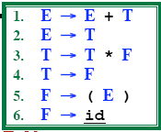
(SLR) Parsing Tables for Expression Grammar
Action Table
Goto Table
state | id | + | * | ( | ) | $ |  | E | T | F
0 | s5 |  |  | s4 |  |  |  | 1 | 2 | 3
1 |  | s6 |  |  |  | acc
2 |  | r2 | s7 |  | r2 | r2
3 |  | r4 | r4 |  | r4 | r4
4 | s5 |  |  | s4 |  |  |  | 8 | 2 | 3
5 |  | r6 | r6 |  | r6 | r6
6 | s5 |  |  | s4 |  |  |  |  | 9 | 3
7 | s5 |  |  | s4 |  |  |  |  |  | 10
8 |  | s6 |  |  | s11
9 |  | r1 | s7 |  | r1 | r1
10 |  | r3 | r3 |  | r3 | r3
11 |  | r5 | r5 |  | r5 | r5
Key to Notation
S4=“Shift input symbol and push state 4”
R5= “Reduce by rule 5” Acc=Accept (blank)=Syntax Error

Slide 47
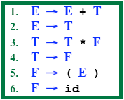

Example LR Parse: (id+id)*id

Slide 48

Example LR Parse: (id+id)*id

Slide 49
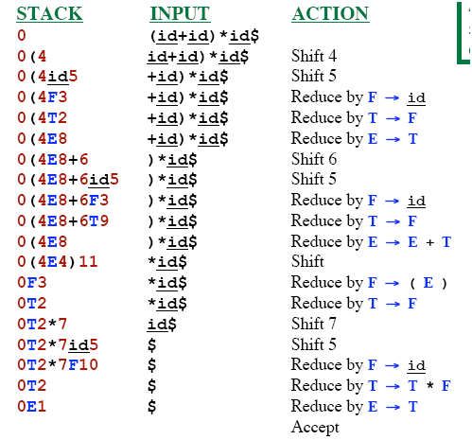
Example LR Parse: (id+id)*id

Slide 50
Actions of A (S)LR-Parser -- Example
stack 0 | input id*id+id$ | action shift 5 | output
0id5 | *id+id$ | reduce by F→id | F→id
0F3 0T2 0T2*7 | *id+id$ *id+id$ id+id$ | reduce by T→F shift 7 shift 5 | T→F
0T2*7id5 | +id$ | reduce by F→id | F→id
0T2*7F10 | +id$ | reduce by T→T*F | T→T*F
0T2 0E1 0E1+6 0E1+6id5 | +id$ +id$ id$ $ | reduce by E→T shift 6 shift 5 reduce by F→id | E→T F→id
0E1+6F3 | $ | reduce by T→F | T→F
0E1+6T9 0E1 | $ $ | reduce by E→E+T accept | E→E+T

Slide 51
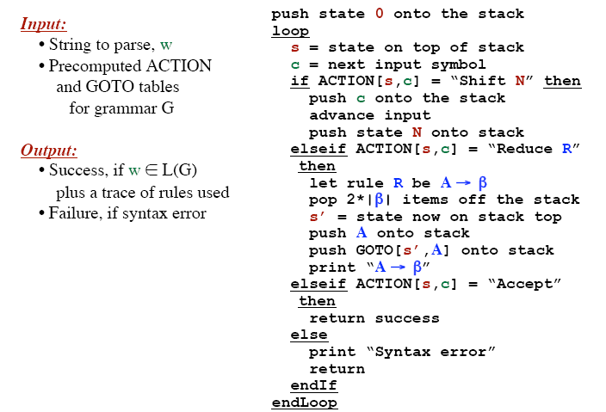
LR Parsing Algorithm

Slide 52
SLR Grammar: Review
An LR parser using SLR parsing tables for a grammar G is called as the SLR parser for G.
If a grammar G has an SLR parsing table, it is called SLR grammar (or SLR grammar in short).
Every SLR grammar is unambiguous, but every unambiguous grammar is not a SLR grammar.
If the SLR parsing table of a grammar G has a conflict, we say that that grammar is not SLR grammar.

Slide 53
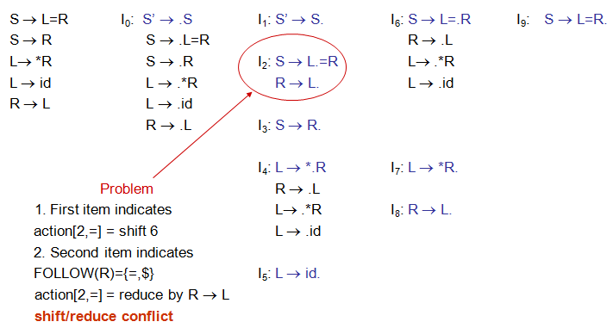
Conflict Example

Slide 54
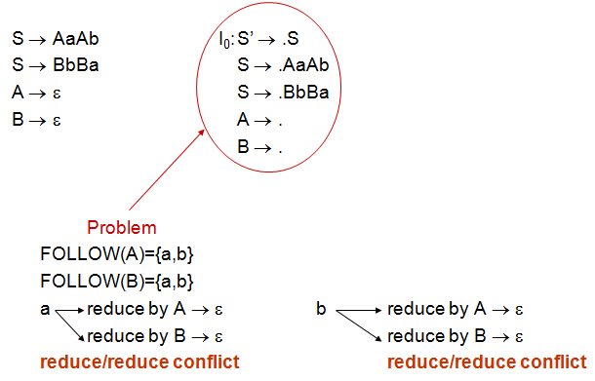
Conflict Example2

Slide 55
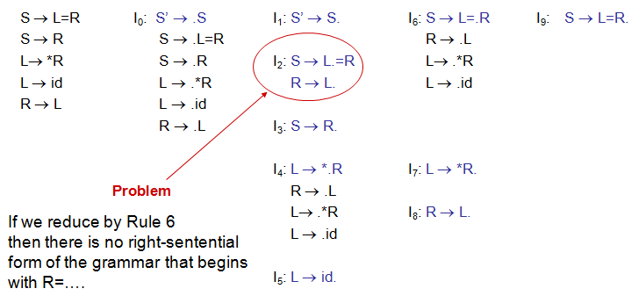
Conflict

Slide 56
Any Questions ?

